Slide 1
The Power of Renewable Energy
Renewable energy is energy derived from natural resources that are replenished constantly, such as sunlight, wind, and water.

Slide 2
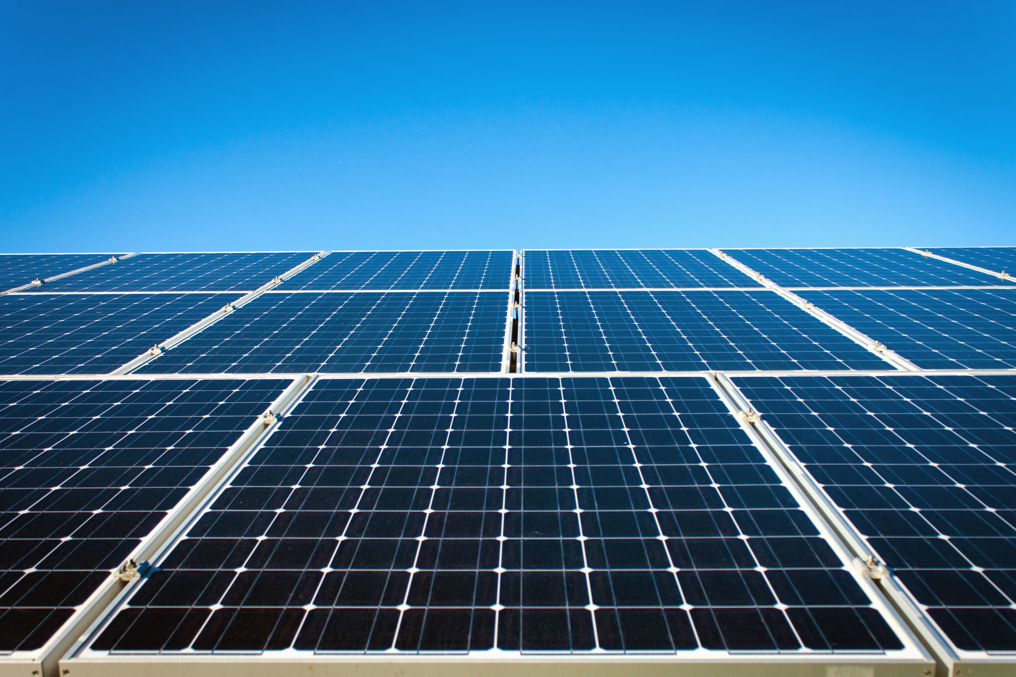
Types of Renewable Energy
Solar Energy: Harnessing the power of the sun.
Wind Energy: Using wind turbines to generate electricity.
Hydro Energy: Capturing energy from moving water.
Geothermal Energy: Utilizing heat from within the Earth.
Biomass Energy: Converting organic material into energy.

Slide 3
Why Choose Renewable Energy?
Environmentally Friendly
Cost-Effective
Energy Independence

